Slide 1
NA4 – The Transport Layer
COMP 256 – Dickinson College
Prof. Braught
Spring 2023
Image from: https://dealna.com/Article/
Post/6564/Networking-Accessories

Slide 2
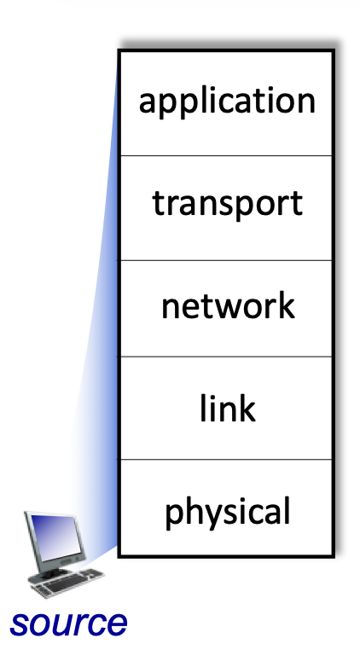
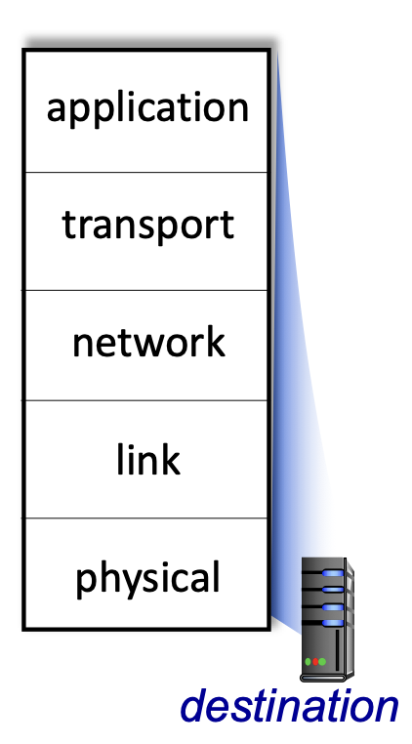
Bridging the Chasm: Network Layers
Getting information from one application to another.
Application Layer Service
HTTP
HTTP
TCP/
UDP
Transport Layer Services
TCP/
UDP
Source
Network Layer Services
Destination
IP
IP
Ether- net
Link Layer Services
Ether- net
Physical Layer Services
Wires
Wires
Image adapted from: http://gaia.cs.umass.edu/kurose_ross/videos/1/5/1.5_video_slides_posted.pptx

Slide 3
Network Data Encapsulation
Data
Data
Data
Data
Link Layer Info
Network Layer Info
Message
Transport Layer Info
Application
Layer Info

Slide 4
Network Protocols
Used for communication between source and destination within a layer
Application (HTTP, SMTP, …)
Transport (TCP/UDP)
network layer (IP)
link layer (ethernet)
Physical layer (encodings)

Slide 5
The Transport Layer

Slide 6
Application Layer

Slide 7
HTTP Protocol

Slide 8
6.7 – Day in the life animation of a web page request…

Slide 9


Acknowledgments
Slide Template From:
https://creativecommons.org/licenses/by/4.0/
Slide Content Licensed as:
Creative Commons Attribution-NonCommercial-ShareAlike 4.0 International License.
Notes:
Note: Individual images may be covered by their own licensing agreements and were incorporated here under fair use. Their use in this slide deck does not change or alter their licensing.

Slide 10
Network Protocols
Used for communication between source and destination within a layer
Application (HTTP, SMTP, …)
Transport (TCP/UDP)
network layer (IP)
link layer (ethernet)
Physical layer (encodings)

